Slide 1
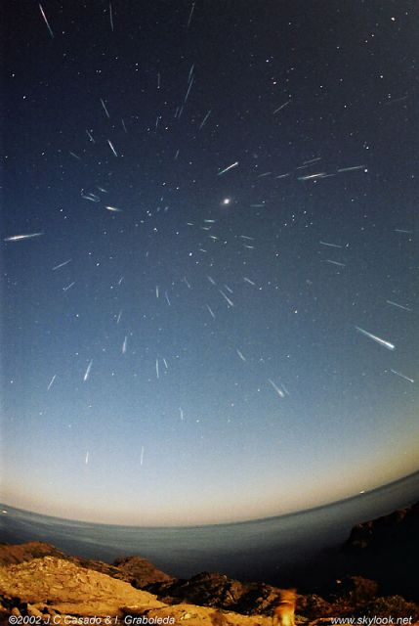
The Solar System
Leonid meteor shower
November 2006

Slide 2
The Solar System
SS overview: members, patterns, …
Earth and other terrestrial bodies
Giant or jovian planets, their satellites, rings, …
Dwarf planets (Pluto and others)
Small SS bodies: asteroids, comets, …
Comparisons between terrestrial bodies; between jovian bodies; between satellites, …
Clues to SS formation and models
Extrasolar planets, planetary systems, …

Slide 3
Solar System—Overview
Overview of the Solar System
SS members large and small
Patterns = clues to formation and history

Slide 4
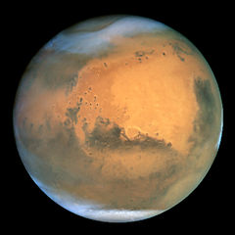
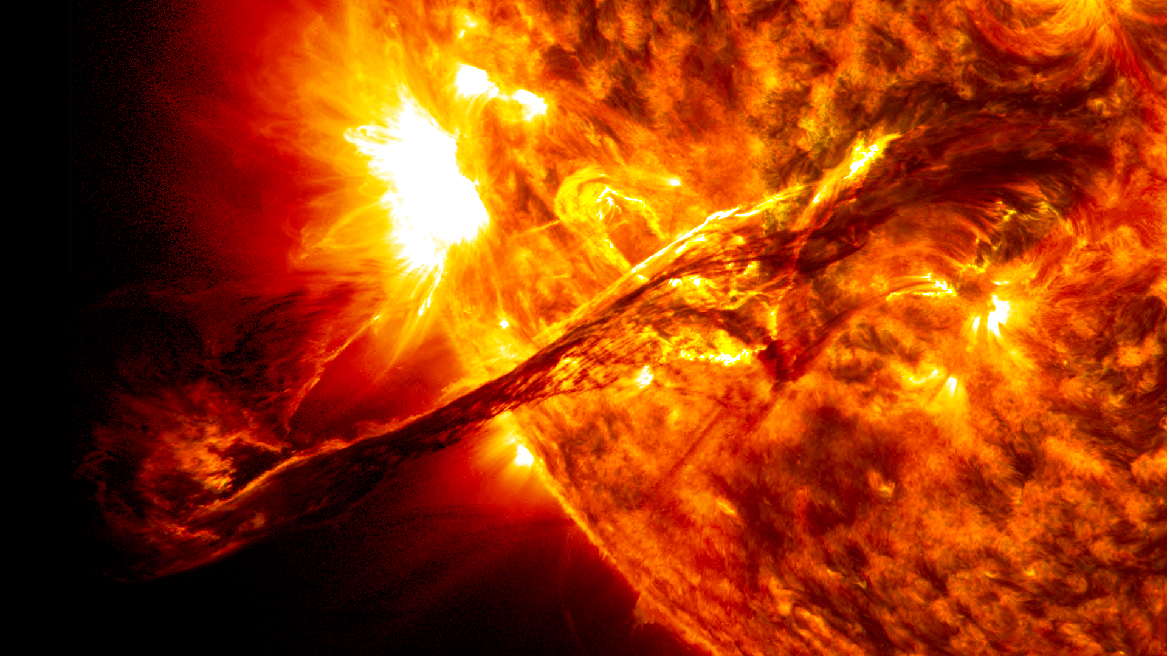
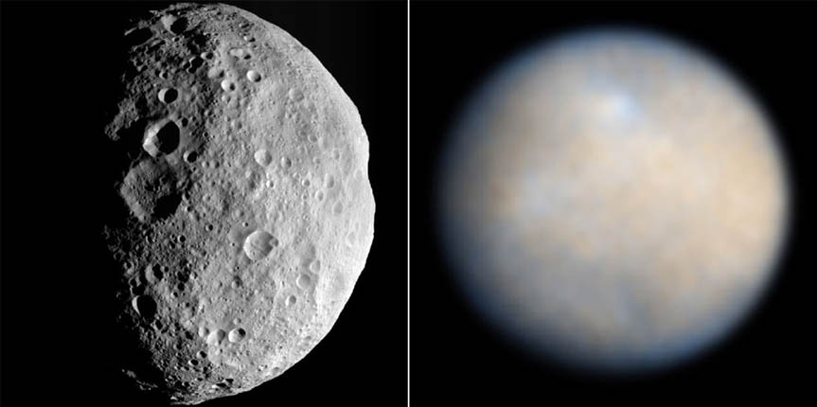
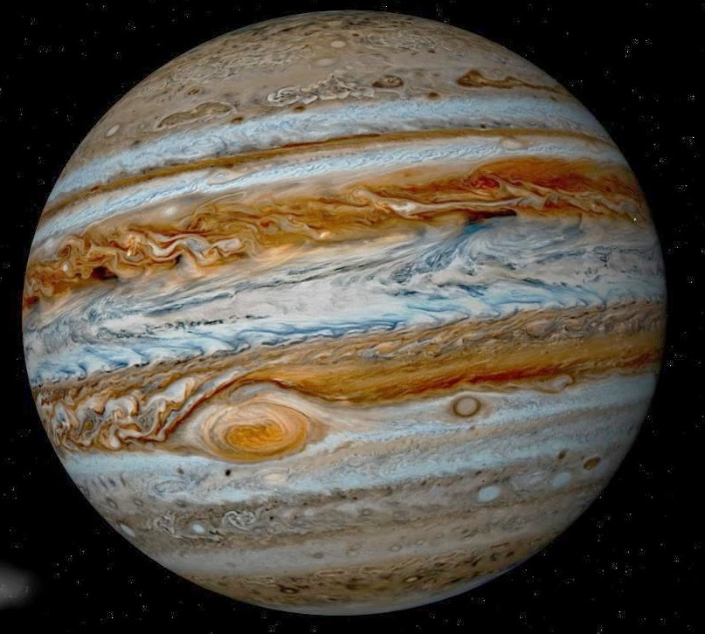
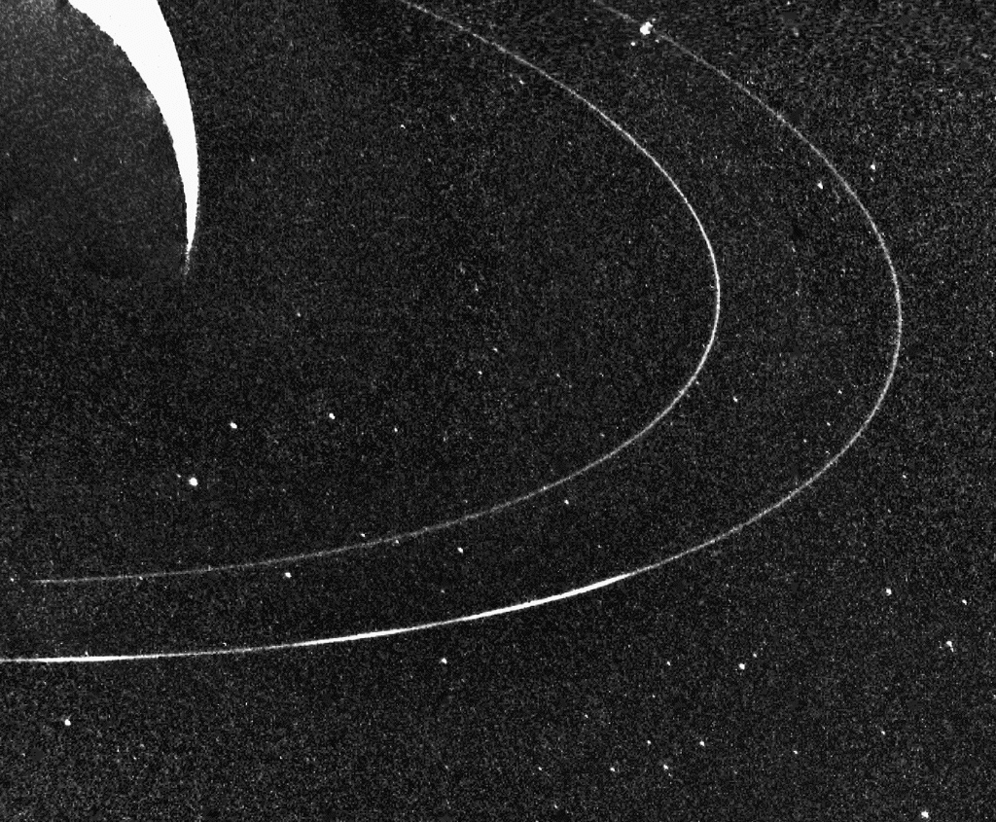
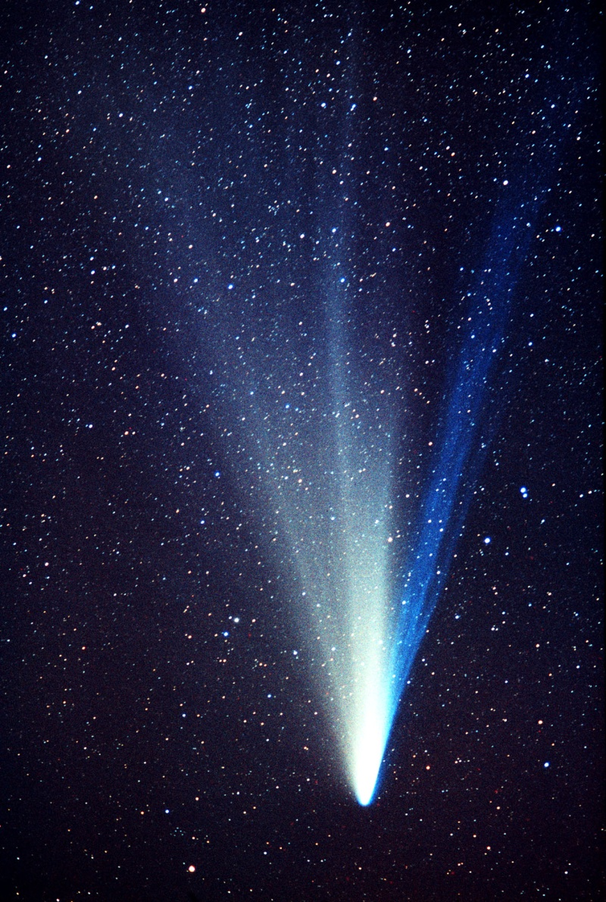
SS Census

Slide 5
SS Census
“category” | number | comment
stars | 1
major planets | 8
dwarf planets | 5 and ?? | Ceres, Pluto, Eris,…
satellites | ≥ 134 | 7 with R>1000km
ring systems | 4
asteroids | >150,000/10⁶? | known/predicted
comets: KBO | 10⁶? | within 30-50AU?
comets: Oort | 10¹³? | not yet directly observed

Slide 6
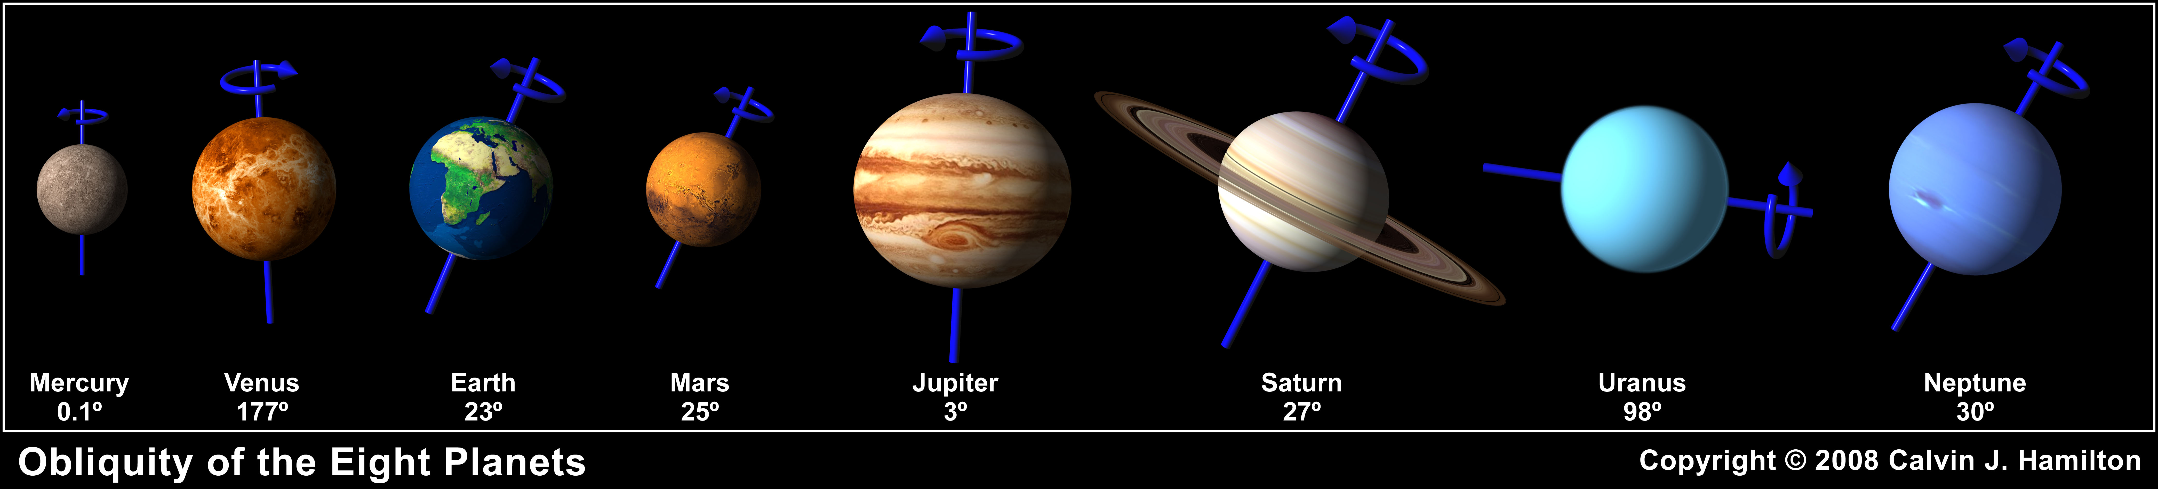
Major Planets

Slide 7
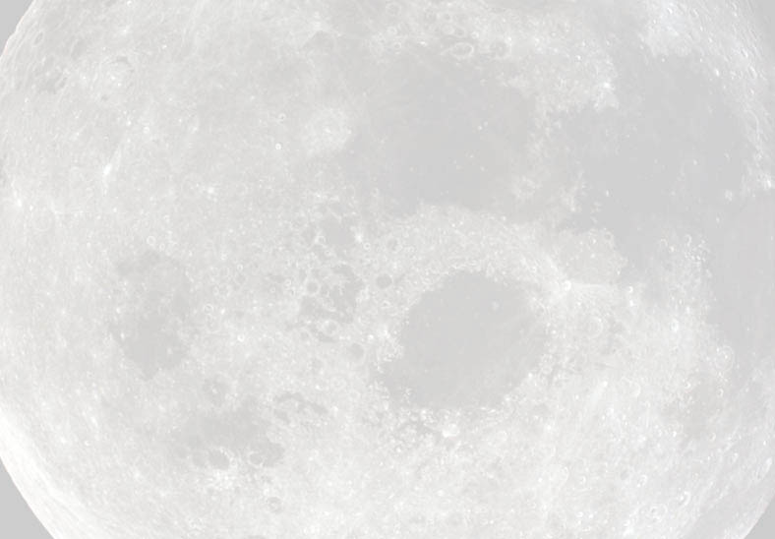
Orbital Properties of the Major Planets
Planet | a (AU) | e | period (y) | inclination | v_{orb} (km/s)
Mercury | 0.39 | 0.206 | 0.24 | 7.0° | 47.87
Venus | 0.72 | 0.007 | 0.62 | 3.39 | 35.02
Earth | 1.00 | 0.017 | 1.00 | 0.0 | 29.79
Mars | 1.52 | 0.093 | 1.88 | 1.85 | 24.13
Jupiter | 5.20 | 0.048 | 11.86 | 1.31 | 13.06
Saturn | 9.54 | 0.054 | 29.42 | 2.49 | 9.65
Uranus | 19.19 | 0.047 | 83.75 | 0.77 | 6.80
Neptune | 30.07 | 0.009 | 163.7 | 1.77 | 5.43

Slide 8
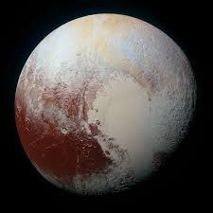
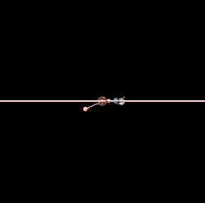
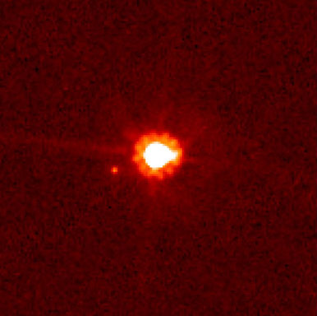
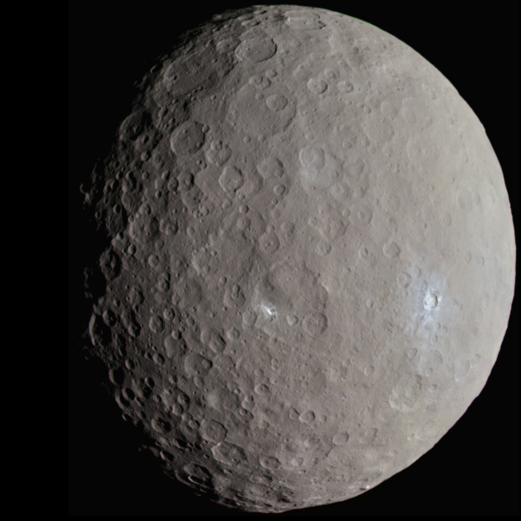
Dwarf Planets
Pluto: “demoted” from major planet to dwarf planet
← Ceres (largest object in asteroid belt)
Eris and its moon Dysnomia →

Slide 9
Orbital Properties of the Dwarf Planets
Dwarf Planet | a (AU) | e | period (y) | inclination | V_{orb} (km/s) | Mass/Moon
Ceres | 2.77* | 0.080 | 4.60 | 10.59º | 17.88 | 0.013
Pluto | 39.48 | 0.249 | 248.1 | 17.14 | 4.67 | 0.178
Haumea | 43.34 | 0.189 | 285.4 | 28.19 | 4.484 | 0.057
Makemake | 45.79 | 0.159 | 309.9 | 28.96 | 4.419 | 0.05
Eris | 67.67 | 0.44 | 557 | 44.2 | 3.44 | 0.227
*largest object in the asteroid belt
“Dwarf planet” is a new category still to be filled: (1) Orbits Sun;
(2) Massive enough for its gravity to crush itself into a hydrostatic equilibrium shape (usually a spheroid); (3) But has not cleared its neighborhood of other material.

Slide 10
Physical Properties of the Major Planets
Planet | radius (km) | mass (kg) | density (kg/m³) | P_{rot} (d) | axis tilt | # moons | rings?
Mercury | 2,440 | 3.30×10²³ | 5,430 | 58.6 | 0.0° | 0 | No
Venus | 6,052 | 4.87×10²⁴ | 5,240 | -243.0 | 177.4 | 0 | No
Earth | 6,378 | 5.97×10²⁴ | 5,520 | 0.9973 | 23.45 | 1 | No
Mars | 3,394 | 6.42×10²³ | 3,930 | 1.026 | 23.98 | 2 | No
Jupiter | 71,492 | 1.90×10²⁷ | 1,330 | 0.41 | 3.08 | 60* | Yes
Saturn | 60,268 | 5.68×10²⁶ | 690 | 0.44 | 26.73 | 31* | Yes
Uranus | 25,559 | 8.68×10²⁵ | 1,270 | -0.72 | 97.92 | 21* | Yes
Neptune | 24,766 | 1.02×10²⁶ | 1,640 | 0.67 | 29.6 | 11* | Yes
* number of known satellites of jovian planets continues to grow; evidence suggests we have found most that are larger than a few km (?)

Slide 11
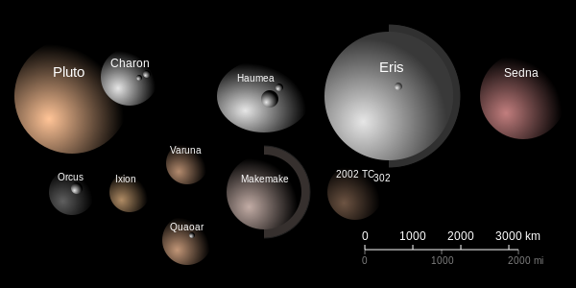
Physical Properties of the Dwarf Planets
Planet | radius (km) | mass (kg) | density (kg/m³) | rotation P (d) | axis tilt | # moons | rings?
Ceres | 471 | 9.41×10²⁰ | 2080 | 0.38 | 4º | 0 | No
Pluto | 1148 | 1.3×10²² | 2000 | -6.39 | 120 | 3 | No
Eris* | ~1200 | 1.5×10²²? | ??? | ??? | ??? | 1 | No
and…
* physical data on Eris (especially mass) currently either poorly known or not known at all…

Slide 12
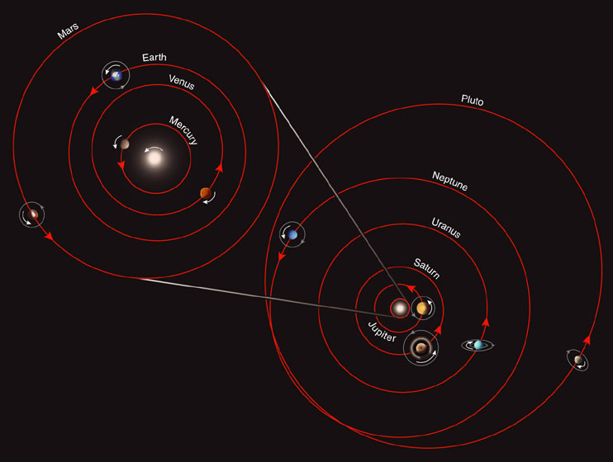
SS viewed from “above Earth’s North pole”
most planetary orbits are nearly circular
all have same orbital direction

Slide 13
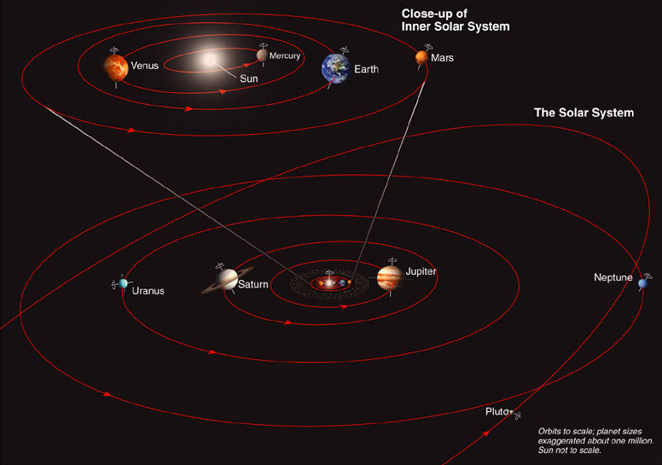
SS viewed close to “edge-on”
most orbits are nearly coplanar
axial tilts vary…

Slide 14
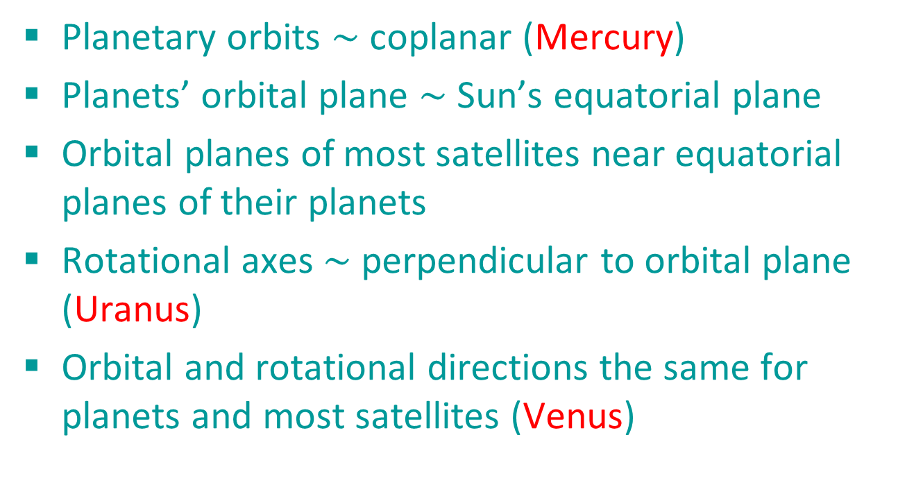
SS Patterns: Orbits
Planetary orbits $\sim$ coplanar (Mercury)
Planets’ orbital plane $\sim$ Sun’s equatorial plane
Orbital planes of most satellites near equatorial planes of their planets
Rotational axes $\sim$ perpendicular to orbital plane (Uranus)
Orbital and rotational directions the same for planets and most satellites (Venus)

Slide 15
SS Patterns: Physical Properties
Inner SS: mainly heavier elements like metal and rock
Outer SS: mainly lighter elements such as gas or ice
Satellites generally share chemistry of their planet – but many interesting variations on this theme

Slide 16
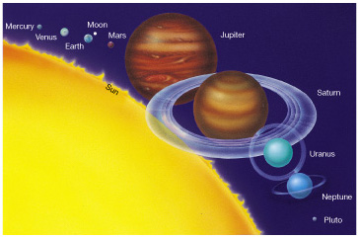
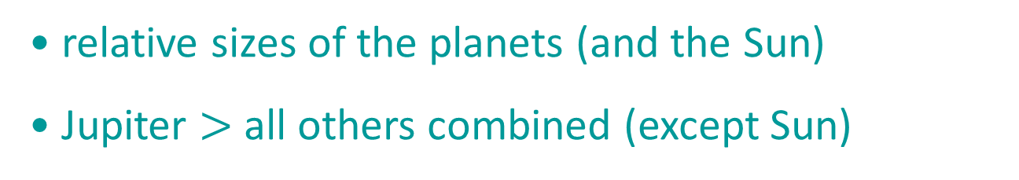
relative sizes of the planets (and the Sun)
Jupiter $>$ all others combined (except Sun)

Slide 17
Terrestrial vs. jovian (giant) Planets
Terrestrial Planets
located in inner part of Solar System
small
rock & metal (high density), with distinct surfaces
few moons
no rings
Giant Planets
in outer part of Solar System
large
gaseous (low density)
many moons
rings
rapid rotation

Slide 18
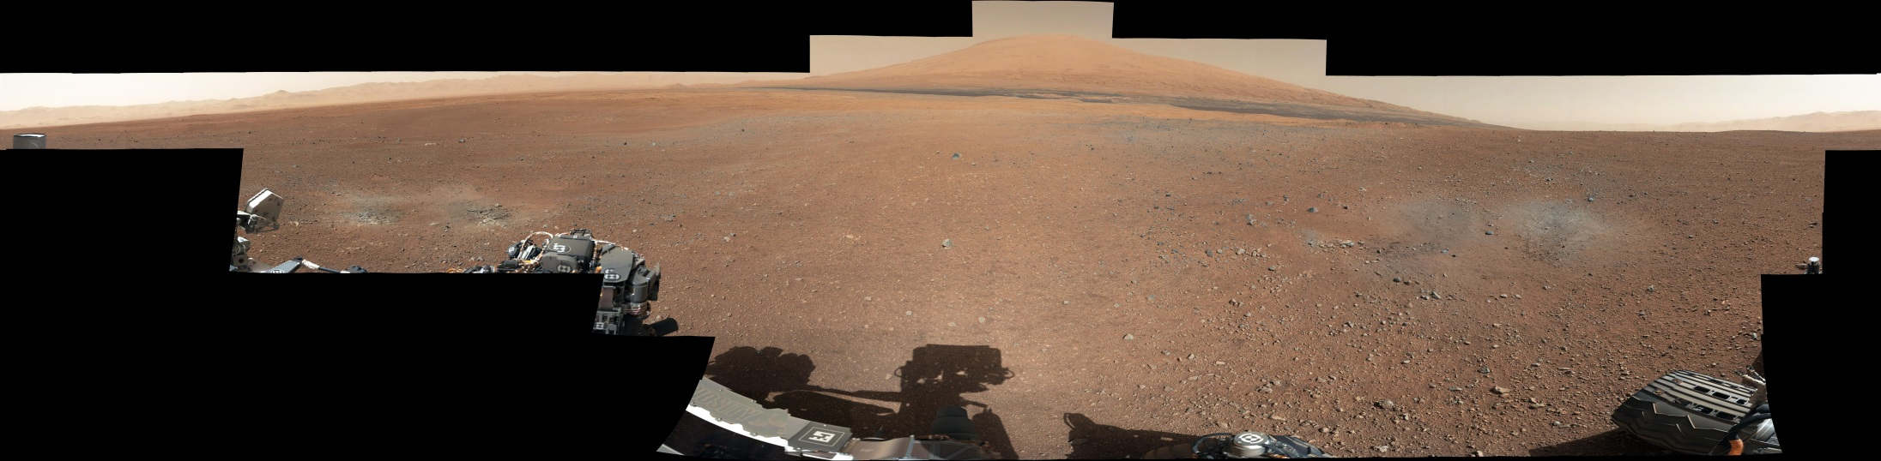
Spacecraft Exploration of the Planets
E.g.: Getting to Mars is hard… Curiosity’s 7 Minutes of Terror

Slide 19
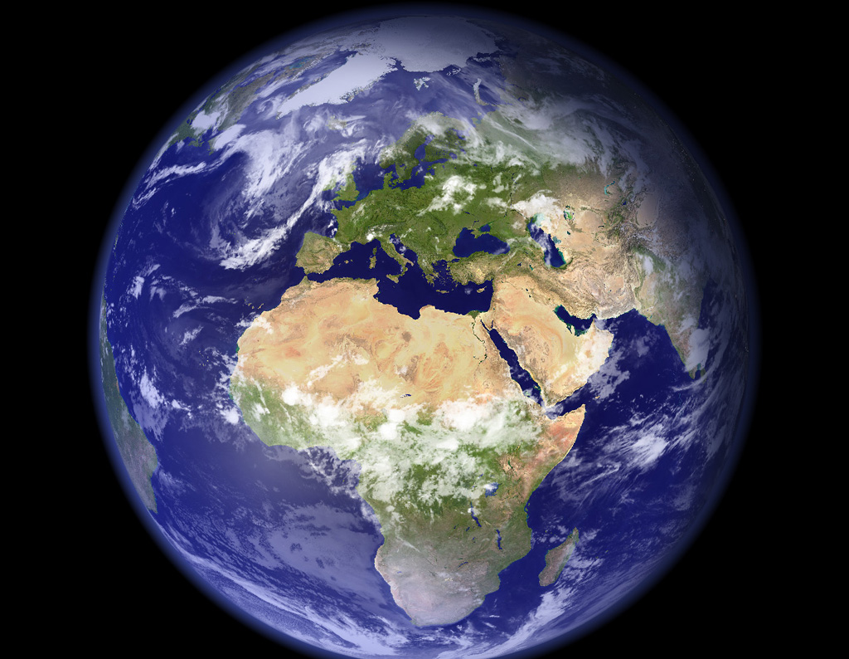
Solar System—Earth
Earth
Prototype “terrestrial” planet
Interior
Magnetic fields
Surface
Atmosphere

Slide 20
Earth: prototype of terrestrial planets
differentiated interior
strong magnetic field
active surface
volcanoes
continental plates
liquid water
atmosphere
N, O, + minor amounts of other gases
greenhouse effect

Slide 21
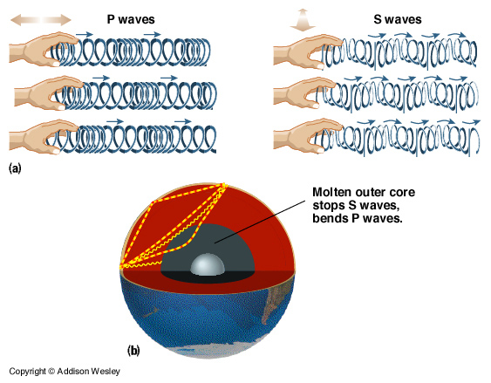
Differentiated interior probed by earthquakes

Slide 22
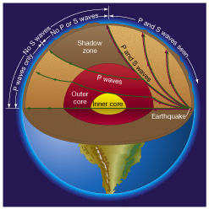
Differentiated interior probed by earthquakes
outer core is fluid
inner core is solid

Slide 23
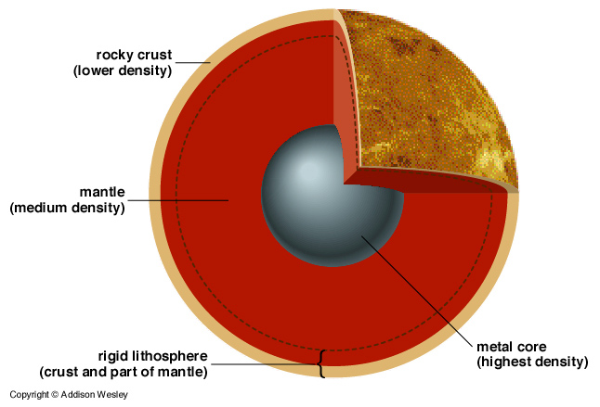
Earth’s interior is “differentiated”

Slide 24
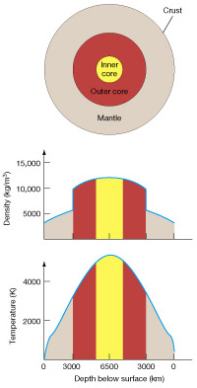
Earth’s interior is “differentiated”
radial structure:
inner core
outer core
mantle
crust
density: ρ_{core} >> ρ_{crust}
temperature: T_{core} >> T_{surface}

Slide 25
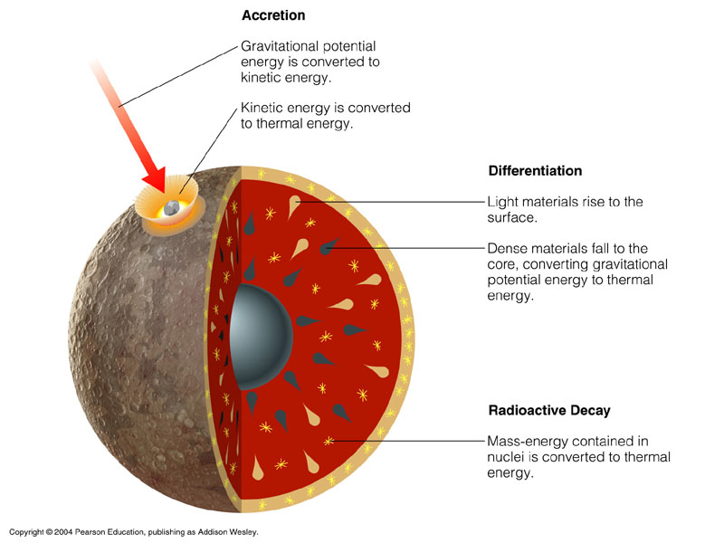
How are planetary interiors heated?
accretion
differentiation
in all cases: heat generated is proportional to planet’s mass
radioactive decay

Slide 26
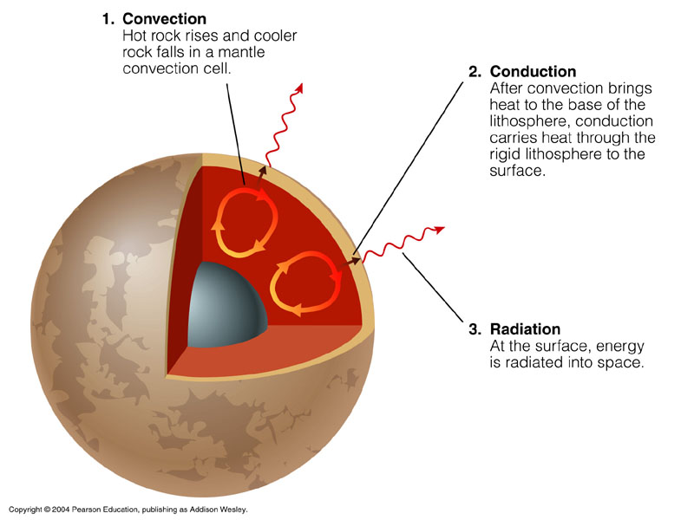
convection
conduction
radiation
ultimately: heat escapes through planet’s surface
How are planets cooled?

Slide 27
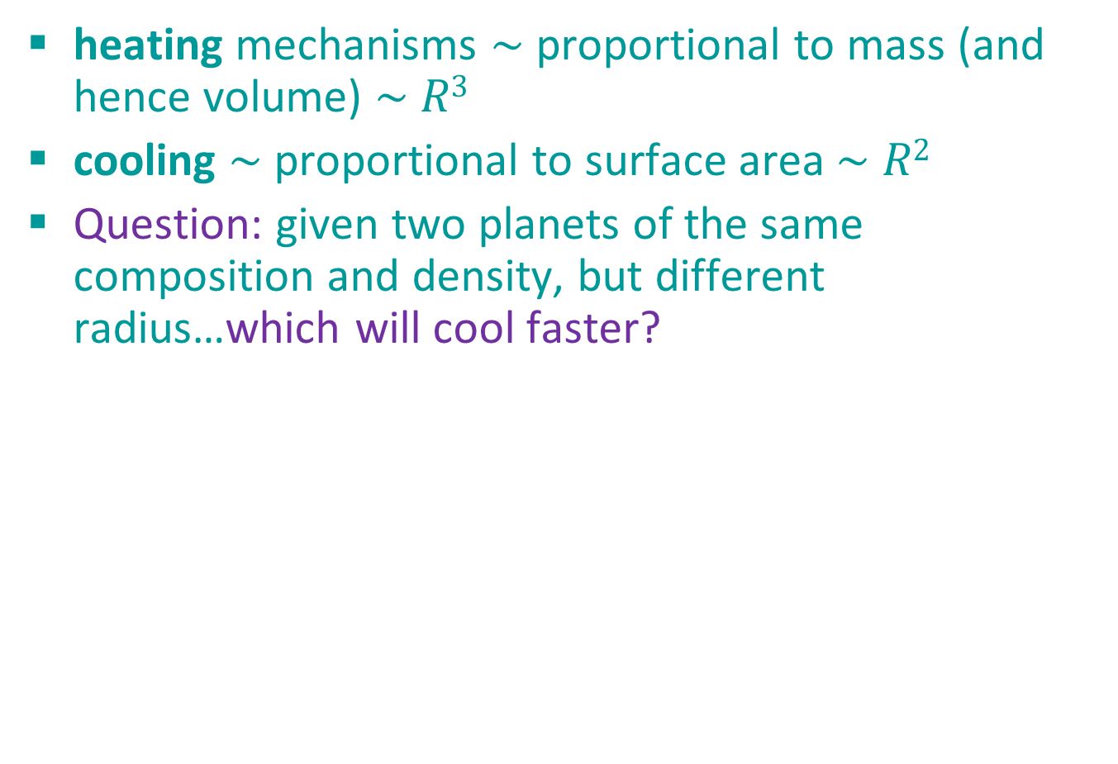
Heating vs. Cooling
heating mechanisms $\sim$ proportional to mass (and hence volume) $\sim$ $R3$
cooling $\sim$ proportional to surface area $\sim$ $R2$
Question: given two planets of the same composition and density, but different radius…which will cool faster?

Slide 28
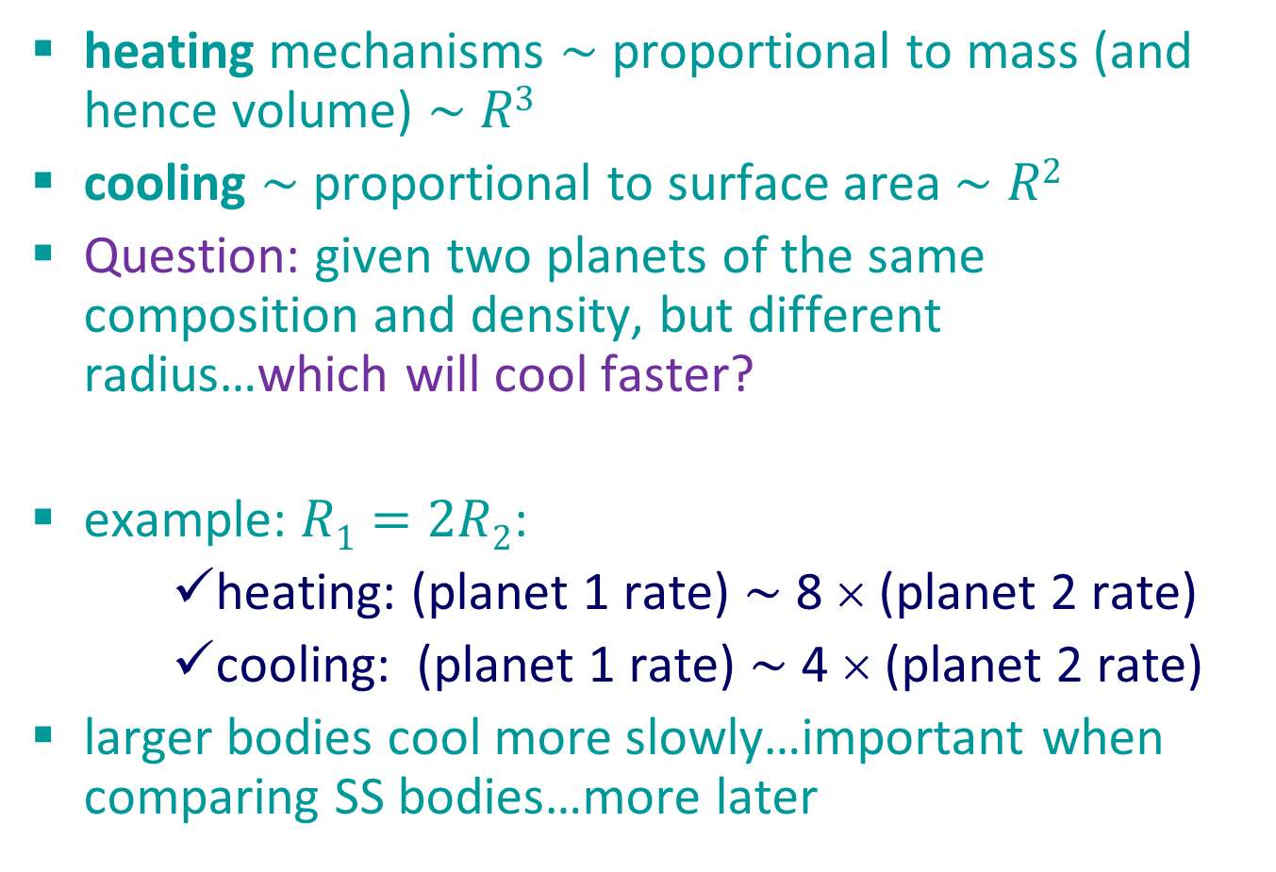
Heating vs. Cooling
heating mechanisms $\sim$ proportional to mass (and hence volume) $\sim$ $R3$
cooling $\sim$ proportional to surface area $\sim$ $R2$
Question: given two planets of the same composition and density, but different radius…which will cool faster?
example: $R1=2R2$:
heating: (planet 1 rate) $\sim$ 8 × (planet 2 rate)
cooling: (planet 1 rate) $\sim$ 4 × (planet 2 rate)
larger bodies cool more slowly…important when comparing SS bodies…more later

Slide 29
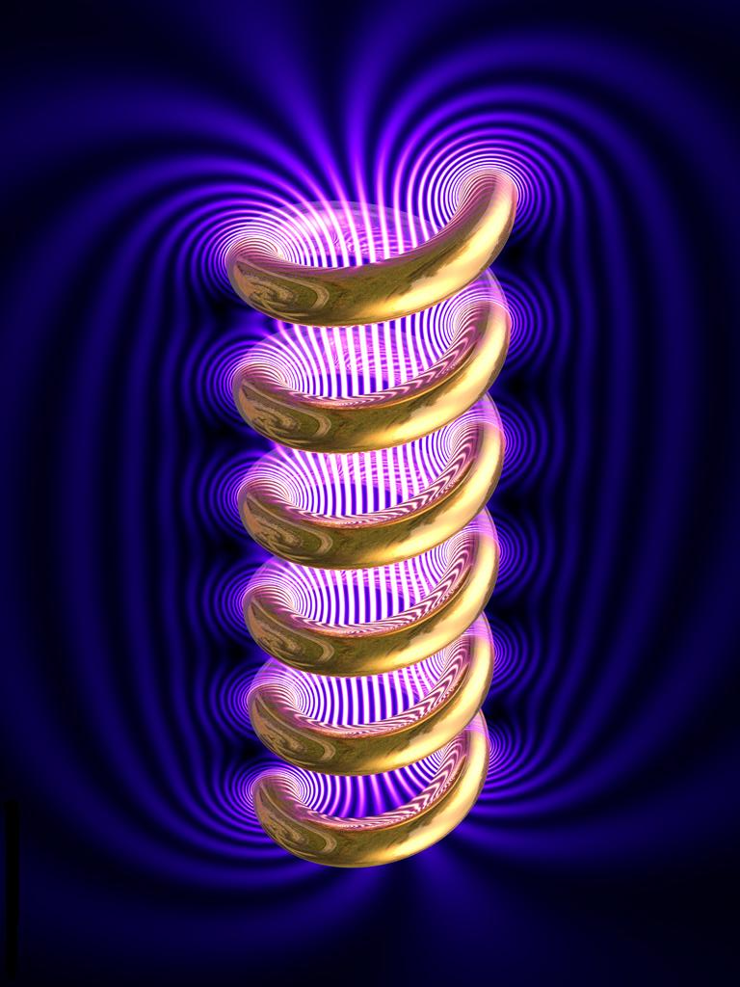
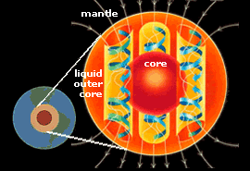
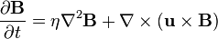
Planetary Magnetic Fields
Dynamically induced and maintained:
An electrically conductive fluid (outer core)
Kinetic energy provided by planetary rotation
Internal energy (thermal) to drive convection
Active research area…

Slide 30
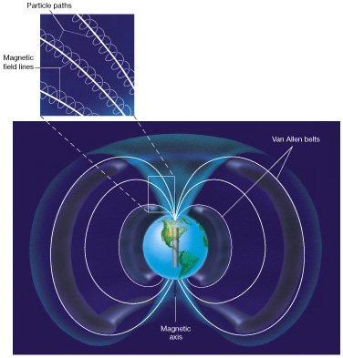
Planetary Magnetic Fields
High above the atmosphere Earth’s magnetic field lines trap charged particles from the Sun (solar wind)

Slide 31
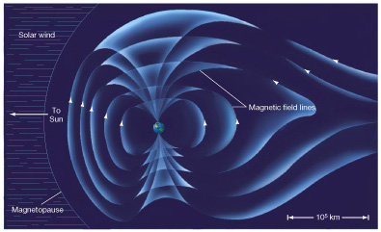
Planetary Magnetic Fields
Solar wind also distorts the shape of the “magnetosphere”

Slide 32
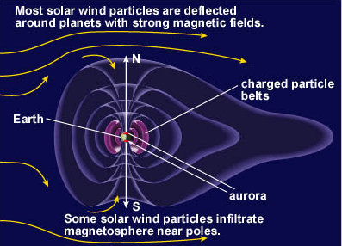
Planetary Magnetic Fields
Solar wind also distorts the shape of the “magnetosphere”

Slide 33
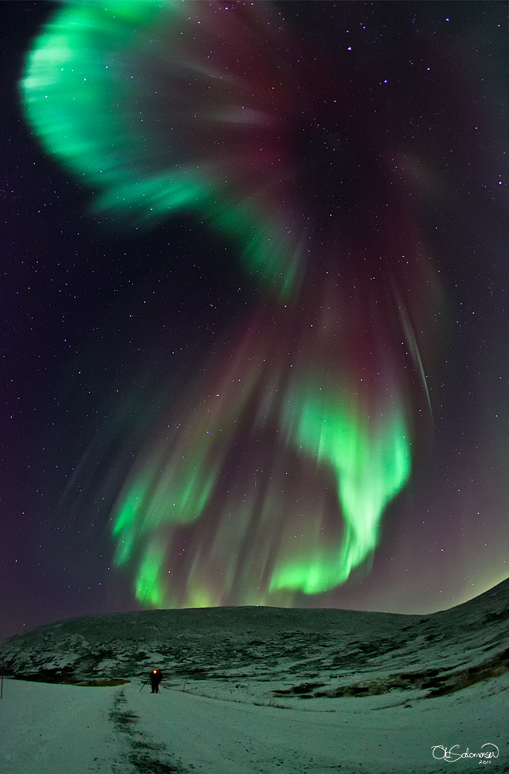
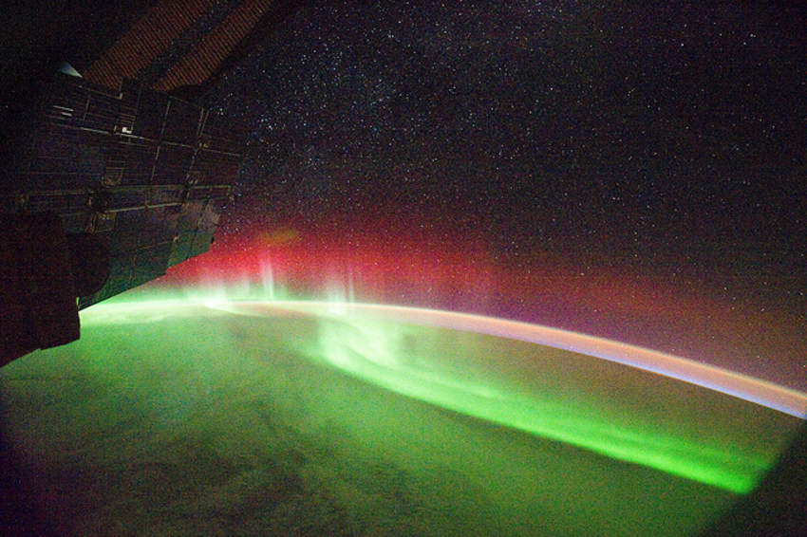
Planetary Magnetic Fields
aurora:
solar wind + magnetic field

Slide 34
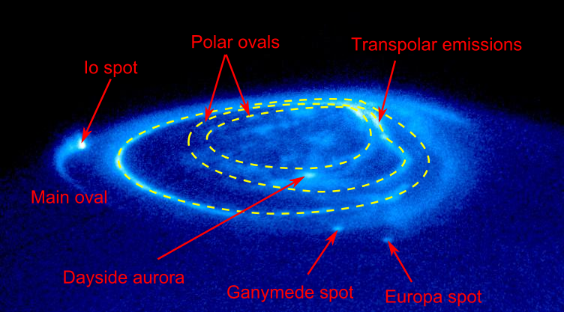
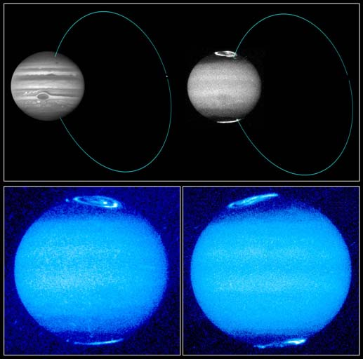
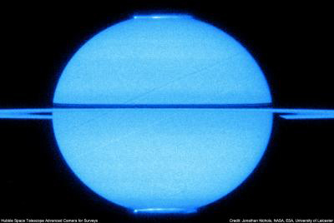
Planetary Magnetic Fields

Slide 35
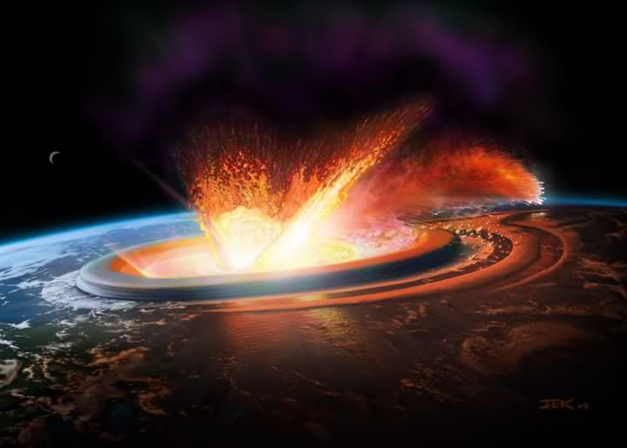
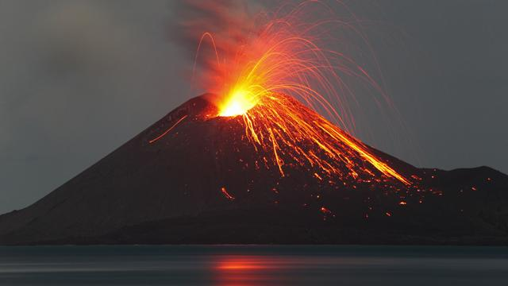
Planetary Surfaces: Earth
continental drift causes constant change to surface:
volcanoes, mountain building, faults, …
erosion of surface (water, wind)
meteorite impacts

Slide 36
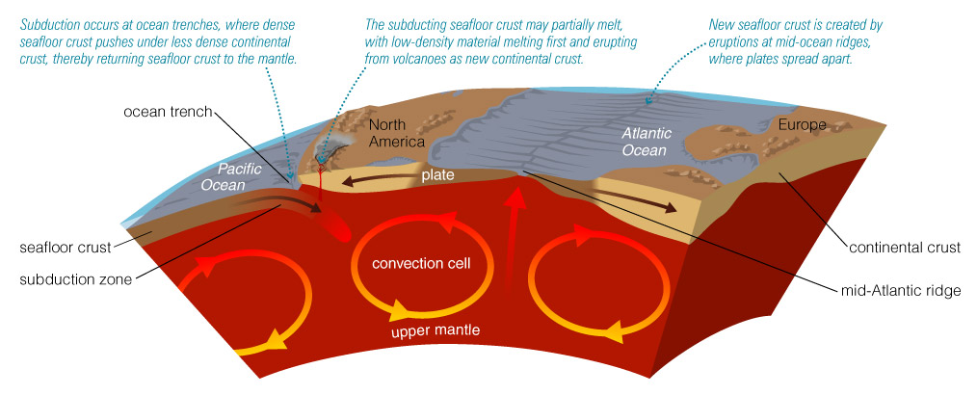
Continental drift (motion of tectonic plates) is driven by convection in upper mantle…
…causing subduction and sea floor spreading

Slide 37
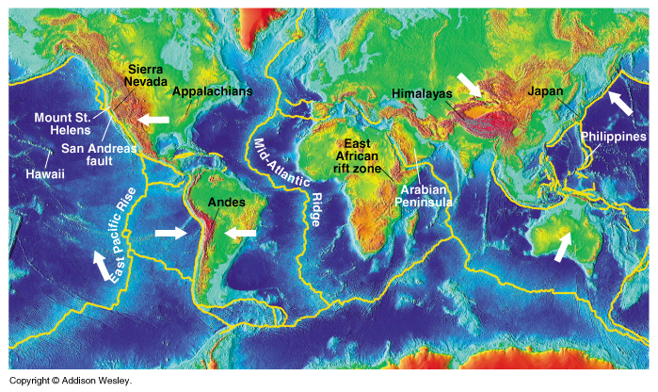
tectonic plates: boundaries and motion

Slide 38
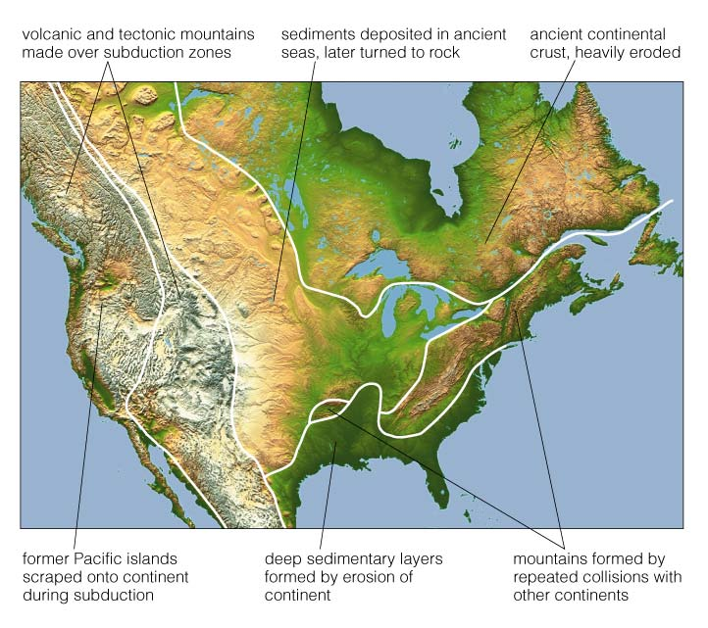
North America today is the result of many processes…
…such as:
subduction
collisions
volcanism
erosion
sedimentary deposits

Slide 39
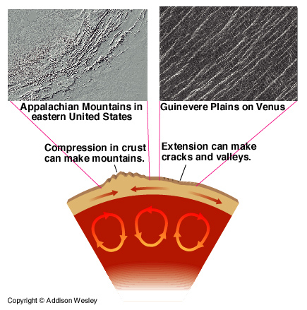
tectonic forces can compress or stretch the crust

Slide 40
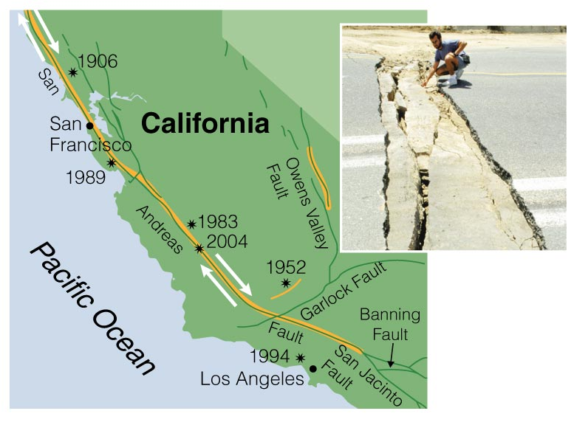
…plates can also slide along each other

Slide 41
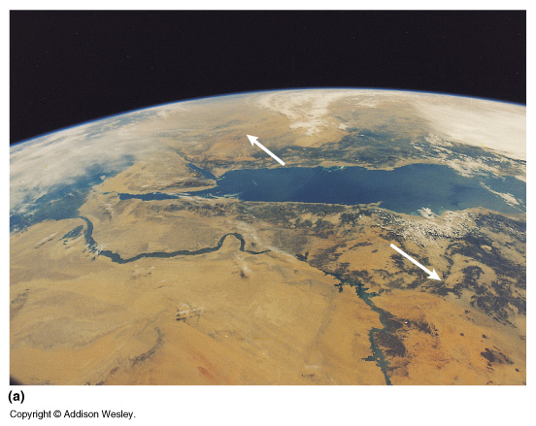
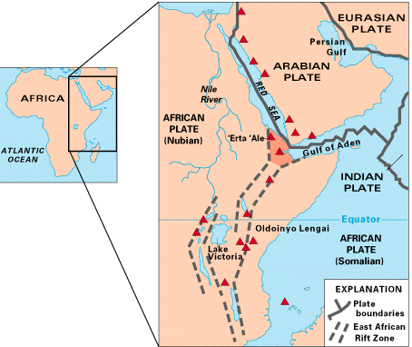
When plates pull apart, crust thins, rift valleys form

Slide 42
tectonic plates: boundaries and motion

Slide 43
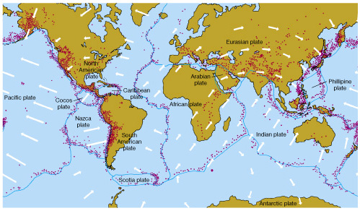
Earthquakes occur mostly at plate boundaries

Slide 44

Africa and South America used to be “together”
What is the future of Earth’s crust, continents?

Slide 45

…will subduction close the Atlantic? Link
…or will plate motion close the Pacific?

Slide 46

Planetary Atmospheres—Overview
Origin of planetary atmospheres: at formation? later from outgassing?
Loss of atmospheric gasses: temperature ($T$), surface gravity of planet, mass of gas atom/molecule
Vertical structure: pressure, temperature… climate depends on heating & rotation of planet
Horizontal structure (circulation): heating & rotation…
Greenhouse effect: surface heating, clouds…
CO₂ and other cycles: weathering, precipitation, chemistry

Slide 47

Planetary Atmospheres: Earth
Earth’s atmosphere (secondary): original all/mostly lost
Atmospheric composition: outgassing, CO₂ chemistry, life
Surface $T$: combination of solar heating, IR radiation trapped by cloud layer
Atmospheric circulation and climate: depend on heating and rotation
Earth’s atmosphere is 78% N, 21% O, 0.9% Ar, 0.03% CO₂, 0.0018% Ne, 0.00052% He, …
CO₂ amount has increased by 10% (from 0.0315% to 0.0355%) in last 40 years; cause of global warming?
Notes:
Got to here on Jan 20, 2011

Slide 48

Earth is illuminated and heated by the Sun
day/night temperature variation depends on rotation speed
Notes:
Blue light is scattered a lot, so that’s why sunsets are red.

Slide 49


Earth’s atmosphere blocks some $λ$, transmits others
Light energy received by one hemisphere, reemitted by all…

Slide 50


Atmospheres have structure
Exosphere:
heated by solar UV + Xray
region of greatest escape (high $T$, altitude)
Thermosphere + Ionosphere:
Xrays heat and ionize
altitude
Stratosphere:
heated by UV light
no convection
Troposphere:
topped by clouds
trapping of IR from surface
radiation, convection important
IR
Temperature →

Slide 51


Atmospheric structure depends on:
$T$, solar radiation, gravity
cloud layers (water vapor) important factor in trapping heat

Slide 52


Greenhouse Effect
Earth’s atmosphere transparent to visible light (from the Sun), which heats the surface
Surface cools by emitting IR light
Earth’s atmosphere not transparent to IR light: CO₂ absorption in IR $λ$ Atmosphere heats up in order to balance incoming heat from sunlight Increasing the amount of atmospheric CO₂ will increase $T$

Slide 53

Atmospheres lose mass by: escape, solar wind, impacts, condensation, chemical reactions

Slide 54


Gas temperature $⇔$ particle velocity, thus probability of escape
in early SS, T>> than at present => major atmospheric loss for terrestrial bodies

Slide 55

Escape of Atmosphere
atmospheric gases can escape if they have low mass (like hydrogen or helium)
since v_{gas} depends on $\sqrt{T/mgas}$, higher $T$ means escape more likely => higher mass gases can escape
to retain a gas of mass m (amu) on a planet with mass M and radius R (in Earth units) the temperature T must be:
molecule | Mass (amu)
hydrogen (H₂) | 2
helium (He) | 4
methane (CH₄) | 16
ammonia (NH₄) | 18
nitrogen (N₂) | 28
oxygen (O₂) | 32
carbon dioxide (CO₂) | 44

Slide 56


CO₂ cycle $⇒$ atmospheric CO₂ abundance
atmosphere → ocean → rocks → atmosphere
atmospheric CO₂ low on Earth because most is bound up in crustal rocks

Slide 57


CO₂ cycle acts as a thermostat for Earth through negative feedback
when atmospheric $T$ is cool, less precipitation => CO₂ ↑
when hot, more precipitation => atmospheric CO₂ ↓

Slide 58

Historical correlation between CO₂ levels and average temperature
since industrial revolution

Slide 59

Atmospheres gain gas due to: outgassing, evaporation, impacts

Slide 60

Atmospheric heating:
creates a circulation cell in each hemisphere
warm air rises near equator and cools as it moves toward the poles
cool air falls near poles and warms as it moves toward the equator

Slide 61


Earth’s Rotation:
also affects atmospheric circulation through the “Coriolis effect”
in a rotating frame, objects do not move in straight lines
on the rotating Earth, horizontally-moving air deviates to the right in the Northern Hemisphere, left in the Southern Hemisphere

Slide 62


Coriolis effect causes circulation:
Low-pressure regions (L) draw in air from surroundings
This horizontally-moving air is deflected into circular flows (CCW in North, CW in South)

Slide 63

Coriolis effect causes circulation cells to divide:
on Earth there are three cells per hemisphere
gas giant planets also show cells, some have more or less than Earth

Slide 64

Coriolis effect causes circulation cells to divide:
on Earth there are three cells per hemisphere
gas giant planets also show cells, some have more or less than Earth

Slide 65



Terrestrial Planets—Comparison
“Face on Mars”
$←$ Viking
Mars Express $↓$

Slide 66
Terrestrial Planets—Comparison
Interiors, atmospheres, surfaces of…
Mercury
Mars
Venus
Moon
Summary and overview of all 5 terrestrial bodies

Slide 67
Terrestrial Planets …properties in “Earth units”
Body | Radius | Mass | density | Atmos. | B Field | Moons
Mercury | 0.382 | 0.055 | 0.984 | No | Weak | No
Venus | 0.949 | 0.815 | 0.951 | Yes | No | No
Earth | 1.0 | 1.0 | 1.0 | Yes | Yes | 1
Moon | 0.272 | 0.012 | 0.605 | No | No | No
Mars | 0.533 | 0.107 | 0.711 | Yes | Weak? | 2
What are the differences and similarities between the “Terrestrial Planets”? Why?

Slide 68

Mercury
least well observed of the “five”
images only from Mariner 10 (1974)
…until Messenger mission (2011)
surface is heavily cratered, has a large impact feature (the “Caloris Basin”)
surface also shows cracks, ridges, scarps, evidence of lava flow….
relatively high density $→$ core is large and iron rich
(weak) magnetic field is a puzzle

Slide 69


High quality data from Messenger…

Slide 70



Caloris Basin

Slide 71

Craters within craters within craters….+lava

Slide 72

Lava Flow Front
Highly fluid Mg-rich basalt comprise the Northern Volcanic Plains.

Slide 73

Long cliffs on Mercury:
indications of cooling and shrinking

Slide 74


Magnetic Field
Weak but stable. How?
High eccentricity → tidal heating → liquid iron core
…but very slow rotation
Interacts with Sun’s magnetic field → magnetic tornadoes

Slide 75

Venus
atmosphere: dense, hot (735K = 462 ºC), 96.5% CO₂, sulphuric acid clouds – extreme Greenhouse effect
at surface P_{atm} $\sim$ 92 P_{earth} (like $\sim$ 1 km under the ocean)
surface data mainly from orbiters with radio (radar) and IR detection, some landers
no magnetic field …due to very slow rotation?
very few craters, even large ones => planet wide resurfacing $\sim 109$ yr ago?
surface has some continents, perhaps active volcanos?
little known about interior (no seismic data)
sidereal day = 243 Earth days retrograde… orbital period = 225 Earth days → day longer than year.

Slide 76


UV image of Venus’ cloud tops:
high winds at cloud tops ($\sim 300$ km/h) but not at surface

Slide 77

Radar image of Venus’ surface:
continents and lowlands
(all female names, e.g. Aphrodite Terra)

Slide 78

pancake domes => thick lava
twisted and fractured crust
volcanic
peaks
a rare impact crater
a “corona”

Slide 79

Volcanic rocks seen at foot of Venera lander

Slide 80


Venus’ cloud tops reflect more sunlight…
…but greenhouse effect $>>$ on Venus vs Earth

Slide 81
Earth vs Venus: Start with similar outgassing of CO₂ and H₂O
Earth: starts slightly cooler
H₂O gas cools, condenses, falls as rain, makes oceans, and evaporates again; H₂O liquid/gas cycle.
CO₂ dissolves in rain → stored in rocks. Photosyn-thesis converts CO₂ to O₂.
Left with almost no CO₂, a little O₂, and H₂O in a cycle (and original “inert” N₂).
Venus: starts slightly warmer
Even if it started with oceans: warmer → more evaporation & air can hold more H₂O → more H₂O greenhouse gas → warmer. Positive feedback.
Oceans evaporate, H₂O photo-dissociates. H → space; O → chemically bound up.
Left with lots of CO₂, no H₂O. Runaway greenhouse effect.

Slide 82




Earth & Venus: Start with similar outgassing of CO₂ and H₂O

Slide 83

Mars
two tiny moons (Phobos [13 km] and Deimos [8 km])
very thin atmosphere, 95.3% CO₂
At surface P_{atm} $\sim$ 0.006 P_{Earth}
temperature $\sim$ 220 K = -50 ºC (-143 ºC to +35 ºC)
very weak magnetic field
surface
N hemi. lower & much less cratered than S hemi.
red from iron oxides
long canyons, “flow” features
volcanoes (Olympus Mons = largest in SS)
polar caps frozen CO₂; seasonal “exchange” with atm.
rotates in 24h 37m 22s

Slide 84



Moons of Mars
Phobos
Deimos

Slide 85

Images of rotating Mars show surface, polar caps, clouds…

Slide 86

Composite image shows N/S difference

Slide 87

Elevation map showing: Martian relief (note N/S differences) & landing sites

Slide 88


Olympus Mons: the largest volcano in the Solar System
26km high!
$\sim$ 3x Everest
Notes:
Last slide o Jan 24,2012

Slide 89

Valles Marineris is long and deep
Large tectonic crack? Widened by erosion? Flow channels?

Slide 90


Mars Landers
1976 – two Viking landers
1997 – Mars Pathfinder and Sojourner (a tiny rover, traveled a few meters)
2003/4 – rovers Spirit (died in 2010) and Opportunity
2012 – Mars Science Laboratory and rover Curiosity

Slide 91
Panoramic view of Gusev crater from the Spirit Lander

Slide 92


some Mars rocks are cooled lava
…and some are sedimentary (interaction with water)

Slide 93

Mars (on left) has long canyons that look very similar to long canyons on the Earth (on right) that are formed by water erosion.

Slide 94



compare with “scablands” →
outflow channel => catastrophic flooding $\sim$ 3x10⁹ yr ago

Slide 95




Curiosity finds ancient river bed

Slide 96


Cave Skylights?

Slide 97

The Moon
mass $\sim$ 1/83 M_{Earth}
largest moon/planet ratio in SS
virtually no atmosphere
surface heavily cratered, especially on side away from the Earth
“maria” much less cratered than “highlands”
tidally “locked” to Earth
10-20 times close to earth at formation

Slide 98

Moon’s surface distinguished by: Maria (smooth, dark), highlands (cratered, bright)

Slide 99

Like Earth, Moon’s interior is differentiated, but the lithosphere is comparatively very thick
Notes:
conitnue here on 31 Jan. 2008

Slide 100


Slide 101

Craters on the Moon are due to impact events
Impact craters found throughout SS

Slide 102

Impact process forms characteristic shape...
impact
ejecta
circular, rimmed, low floor

Slide 103

Maria and Highlands are different in age

Slide 104

Apollo astronauts returned samples from many locations
Notes:
Got t here on 25 Jan, 2011

Slide 105
Lunar missions
Lots of missions currently at Moon, planning for orbital missions, landers, astronauts on surface
US, India, Russia, China
Why?
Science
Preparation for exploration beyond

Slide 106
Comparative Planetology…
interiors – role of mass
atmospheres – role of mass, distance from sun
surfaces – liquid water, lava, tectonics, impacts, surface age

Slide 107

All terrestrial bodies are differentiated
=> All had hot (and fluid) interiors at some time

Slide 108

Larger terrestrial planets:
cooled more slowly
more and longer lasting tectonic activity
easier to retain atmosphere

Slide 109

For planets closer to the sun:
higher T
harder to retain liquid water, atmospheres

Slide 110

higher rotation => more “weather”

Slide 111

fewer impact craters on massive planets:
cooled more slowly
atmospheres shield only against small impactors

Slide 112

Terrestrial surfaces have different “ages”
Surfaces too “new” to see early heavy bombardment
Crustal rock solidified globally first on Moon, last on Earth

Slide 113

jovian (Giant) Planets
Jupiter true-colour mosaic image from Cassini spacecraft
(Dec 29, 2000)

Slide 114
Overview of the Giant Planets
interiors
atmospheres & “surface” features
magnetic structures
moons
rings

Slide 115
Physical Properties of the jovian Planets (mostly Earth units)
Planet | radius | mass | Density (kg/m³) | P_{rot} (d) | axis tilt | Mag. field? | g_{surf}
Earth | 6,378km | 5.97×10²⁴ kg | 5,520 | 0.9973 | 23.45 | Y | 9.8m/s²
Jupiter | 11.2 | 317.9 | 0.24 | 0.41 | 3.08 | Y | 2.36
Saturn | 9.5 | 95.2 | 0.12 | 0.44 | 26.73 | Y | 0.92
Uranus | 4.0 | 14.5 | 0.23 | -0.72 | 97.92 | Y | 0.91
Neptune | 3.8 | 17.1 | 0.30 | 0.67 | 29.6 | y | 1.14
Low density
Fast rotators
big

Slide 116

jovian planets: size comparison
Jupiter, Saturn similar
Uranus, Neptune similar
all >> Earth

Slide 117

the giant planets are rapidly rotating, large gravitationally bound balls of “fluid”.
although gravity tends to pull fluid together into a sphere, rotation flattens this into an ellipsoid.

Slide 118

Saturn is the most oblate giant planet
R_{polar} = 0.9 R_{equatorial}

Slide 119

jovian planets: all have differentiated interiors
All are primarily made of hydrogen and helium, even in outermost parts of their atmosphere, except in cores (rocks and metals)

Slide 120


Differentiation of Jupiter’s Interior
$\sim$ 90% hydrogen
$\sim$ 10% helium
(by number of atoms)
…almost same as Sun

Slide 121

The Structure of Jupiter’s Atmosphere
as with terrestrial atmospheres: clouds, $T(altitude)$

Slide 122


atmospheres $\sim$same structure…
differences: $T$_{max}, pressure, some composition

Slide 123

Bands in Jupiter’s atmosphere:
result of heat, convection, rotation (Coriolis)
visible light image
IR image

Slide 124

Jupiter’s Great Red Spot is a high pressure storm region

Slide 125

Saturn too has bands and storms, but less prominent

Slide 126

Neptune and Uranus’ blue colour:
methane absorbs red λ and reflects blue

Slide 127

all 4 jovian planets have strong magnetic fields and huge magnetospheres
Uranus’ and Neptune’s magnetic fields strongly tilted relative to rotation axis

Slide 128

…we also see auroral zones near the magnetic poles

Slide 129

jovian planets (except Uranus) have “extra” internal heat sources
Planet | T_{BB}(obs) | “Total” Power | Internal Power | *Extra Source
Jupiter | 127K | 2x input | 4x10¹⁷ W | Contraction?
Saturn | 97 | 2.8x | 2x10¹⁷ | Helium rain?
Uranus | 58 | $\sim$ 1x | 10¹⁵ | None
Neptune | 56 | 2.5x | 3x10¹⁵ | Contraction??
*Usual sources: Primordial accretion & differentiation; radioactivity

Slide 130

Saturn: prominent ring system, more subtle bands

Slide 131
Saturn
similar to Jupiter but smaller
layered banded atmosphere
hydrogen/helium – but helium abundance about half of Solar in outer layers (Helium rain?), methane, ammonia
strong magnetic field
metallic hydrogen and rocky core
rings are most massive and prominent of all

Slide 132


Saturn’s north pole (Cassini)

Slide 133
Uranus
accidentally diskovered telescopically in 1781
faint features, blue atmosphere
hydrogen, helium, methane clouds
strong magnetic field
hydrogen NOT metallic, rocky core
rotation axis tilted 98º → very strong seasonal effect

Slide 134


Uranus: almost completely featureless in visible light
…but shows more detail in IR

Slide 135
Neptune
position predicted from observations of Uranus
diskovered in 1846
very similar to Uranus, but not as “hazy”
more cloud features (isolated dark clouds above methane cloud layer)

Slide 136

Neptune shows large storm features, like Jupiter
The storms change over timescales of years or less

Slide 137

jovian satellites:
some large, many small
some geologically active, now or in the past
some formed with planet, some captured
Current numbers (Jan, 2012)
Jupiter: 66
Saturn: 62
Uranus: 27
Neptune: 13
http://ssd.jpl.nasa.gov/?sat_diskovery

Slide 138
Jupiter’s Large Satellites
Io
geologically active (with active volcanoes!)
covered in orange sulfur compounds
strongly tied to Jupiter’s magnetic field
Europa
smooth surface with few craters
water ice, possibly over liquid water
Ganymede
largest moon in the Solar System
water ice over much of surface
Callisto
heavily cratered
concentric circular ridges are signs of a large impact

Slide 139

…called the four “Galilean” satellites
Io Europa Ganymede Callisto
surface “age” ↑ and mean density ↓ with distance from Jupiter

Slide 140
Io: most volcanically active body in SS

Slide 141

Io: volcanoes are frequent
…constantly changing its surface appearance

Slide 142


Slide 143

Io: tidal interaction and eccentric orbit heat its interior

Slide 144

Io, Europa, Ganymede: and orbital resonance

Slide 145


Charged particles escaping Io interact with Jupiter’s magnetosphere => Io torus
Periodic variability in
radio emission from
torus first observed
in 1960s

Slide 146

Ganymede’s smooth surface and cracked terrain
the result of tidal heating and icy composition

Slide 147


Slide 148

Just below Europa’s surface: liquid water or warm convecting ice?

Slide 149

Ganymede’s surface shows both old and young regions

Slide 150

Callistos surface is the “oldest” (i.e. most aged) of the four Galilean satellites

Slide 151
Saturn’s Moons
many moons, but probably a large number still to be diskovered
Titan: largest of Saturn’s moon’s – has a dense, thick nitrogen atmosphere, extending far out into space, and lakes of liquid methane/ethane (-180 ºC)
innermost moons tidally locked to planet
moons interact with rings

Slide 152

Titan: Saturn’s largest moon
Thick atmosphere:
90% nitrogen + argon, methane & ethane;
smoggy

Slide 153

Huygens probe provided first look at Titan's surface in early 2005.
It found liquid methane lakes and "rocks" made of ice.
saturn.jpl.nasa.gov
VIDEO

Slide 154

Saturn’s Medium-Sized Moons: varied, enigmatic
Darth Crater
Almost all show evidence of (water) volcanism/tectonics

Slide 155

Saturn’s Medium-Sized Moons: varied, enigmatic
Ice fountains of Enceladus suggest it may have a subsurface ocean.
Heat source: tidal heating?
Notes:
(Enchiladas)

Slide 156

Titan from Cassini

Slide 157

Titan, Dionne, and Pandora from Cassini

Slide 158

Iapetus from Cassini

Slide 159

Hyperion from Cassini
Notes:
Surface made of ice.
Meteor impacts create the sponge-like appearance, because of its weak gravity, the impact doesn’t go straight in, but it shoots the surrounding ice up.

Slide 160
Uranus’ Moons
more than 20 small ones, some irregular in shape, some retrograde
five midsized: Miranda, Ariel, Umbriel, Titania, Oberon
All icy, varied geological history
Miranda is strange – very fractured surface, some cataclysmic event?

Slide 161

near IR image shows Uranus’ rings and seven of its moons

Slide 162

Uranus’ Miranda shows a fractured surface, obvious violence, but from what? Past tidal heating/tectonic?
messed-up
Miranda

Slide 163
Neptune’s Moons
five small inner moons near ring system
two larger, icy…
five small outer, retrograde
Triton
very much larger than any other Neptune moon
has thin nitrogen atmosphere
surface has nitrogen geysers
retrograde (backwards) orbit (→ captured?)
spiraling in towards Neptune

Slide 164

Triton: Neptune’s largest moon
Thin nitrogen atmosphere
Surface reshaped by geological activity
Notes:
Got to here on Feb 1. 2011. got to here Jan 26, 2012

Slide 165

Rocky Planets versus Icy Moons
Rock melts at higher temperatures.
Only large rocky planets have enough heat for activity.
Ice melts at lower temperatures.
Tidal heating can melt internal ice, driving activity.
Notes:
Got to here on Feb 1. 2011. got to here Jan 26, 2012

Slide 166

Saturn’s Rings: the brightest & best known
within “Roche Limit” of Saturn, where any gravitationally bound bodies break up due to Saturn’s strong tidal forces
composed of icy particles with sizes between 1 micron and 10 meters, orbiting independently like tiny moons; clumping/splitting
Interesting features:
rings are very thin – at most a few tens of meters, while > 10,000 km across in radial direction!
fine rings within each ring, like record grooves: “spiral density waves”
short-lived “spokes”
braided rings
“shepherd” satellites

Slide 167

Saturn’s rings are wide, thin, and complex
Radio image
colours →
particle size
purple: mainly >5cm
green: mainly <1cm
white: particle
density too high

Slide 168

Like record grooves

Slide 169


Spiral density waves (like spiral arms of galaxies) caused by orbital resonances with moons

Slide 170

Shepherd moons control the width of some ringlets…

Slide 171

…and also make gaps

Slide 172

Orbital resonance with a larger moon can also produce a gap.
(e.g. Mimas and the inner edge of Cassini Division)

Slide 173

Radial “spokes”: cannot be explained with gravity alone …charged particles briefly suspended above ring plane electrostatically?
Notes:
Theory: Lightning from saturn have built up charge that creates these spokes.

Slide 174


Galileo spacecraft shows rings around Jupiter
ring particles are small dark dust particles: debris from Metis…

Slide 175


Near IR image shows rings around Uranus and some of its moons

Slide 176

Neptune’s rings are narrow and bright with dusty regions

Slide 177

Origin of Rings (?)
Many small moons inside Roche limit cannot accrete to larger moons.
These moons suffer continual impacts from meteorites (“sandblasting”) and occasional larger collisions
Saturn's incredible rings may be an “accident” of our time.

Slide 178

Small Bodies of the Solar System
the inner SS is filled with asteroids and other small bodies

Slide 179
Small Bodies of the Solar System
Asteroids
Orbits
Shapes and masses
Meteors and meteorites
Composition
Destructive effects on Earth
Comets
Structure
Place of origin
Dwarf planets
Pluto and its satellites
others…what is the definition of dwarf planet?

Slide 180

Asteroids
leftovers of planet formation: small rocky bodies, no atmosphere, orbit the Sun
first (largest) asteroid, Ceres, found in 1801: now a dwarf planet…
a = 2.77 AU, P=4.6 years, diameter D = 940 km
150,000 now catalogued, probably > 1 million with D > 1 km
small asteroids more common than large; total mass < small planet
most in “Asteroid Belt” at a = 2-3.3 AU mostly low eccentricities
a few have “Earth-crossing” orbits, most have D < 1 km
Trojan asteroids are in Jupiter’s orbit: i.e. a=5.2AU
orbital resonances with Jupiter alter orbits
three types are roughly: carbonaceous (very dark, carbon, 75% of all), siliceous (silicates, 15%), metallic (iron, rarest type)

Slide 181


Distribution of asteroids: semimajor axes mainly 2-3.5AU
Some asteroids have more eccentric orbits bringing them inside Earth’s orbit or beyond Jupiter’s
Trojan asteroids: Lagrange points L4 and L5 at ±60º

Slide 182

Orbital resonances with Jupiter
Asteroids in orbital resonance with Jupiter experience periodic nudges.
Eventually, those nudges move asteroids out of resonant orbits, leaving gaps in the asteroid belt.

Slide 183
Origin of Asteroid Belt
Rocky planetesimals between Mars and Jupiter did not accrete into a planet.
Why? Jupiter's gravity, through influence of orbital resonances, stirred up asteroid orbits and prevented their accretion into a planet.

Slide 184




asteroid sizes determined in many ways (brightness, reflectivity, etc)... can confirm with spacecraft closeups
Gaspra:
16km
Ida:
53km
Mathilde:
59km
Eros:
40km

Slide 185


masses determined from binary asteroids + Kepler → densities too...
Eugenia + moon
Ida and Dactyl
Densities → range of composition and structure: rubble, rock, metal, ice

Slide 186

Vesta from Dawn
Launched 2007, reached Vesta July 2011, departure July 2012 for Ceres – arrival in July 2015

Slide 187

Vesta- closeup from Dawn in late 2011, showing landslide

Slide 188


Meteors and Meteorites
Meteorite: a rock from space that falls through Earth’s atmosphere
Meteor: the bright trail left by a meteorite (“shooting star”)
Meteorite types: mostly same as asteroid types:
Primitive: unchanged in composition since they first formed 4.6 billion years ago (history!)
Processed: younger; have experienced processes like volcanism or differentiation
largest meteorite found $\sim$ 2000 kg
organic materials found in some

Slide 189

meteor: a bright streak produced when a piece of interplanetary debris heats the atmosphere

Slide 190

this car was hit by a 12 kg meteorite
analysis of the meteor’s path through the atmosphere shows it originated in the asteroid belt

Slide 191

Stony meteorite
Iron meteorite
…with dark, smooth crust created by surface melting
characteristic crystalline patterns → slow cooling inside larger body

Slide 192

primitive meteorites:
unchanged since formation; ages ≤4.6x10⁹yr
Stony primitive
Carbon-rich primitive

Slide 193

processed meteorites: fragments of larger bodies that underwent differentiation
Metal-rich processed (large asteroid core)
Rocky processed (like volcanic rocks on Earth)

Slide 194

Comets

Slide 195
Comets
distinguished from comets by appearance: coma, tail…
formed beyond “frost line,” comets are icy counterparts to asteroids: “dirty snowballs”.
most remain perpetually frozen in the outer solar system; grow tails if they approach Sun
virtually all have very eccentric orbits, but there appear to be two populations
short period from “Kuiper Belt”: P < 200yr
long period from “Oort Cloud”: P > 200yr
complicated structure that changes with time
relatively low mass, icy objects (H₂O, CO₂ )

Slide 196

Comet Hale-Bopp over Arizona
bright coma and two tails…

Slide 197

Anatomy of a Comet
coma: atmosphere that comes from a comet's heated nucleus.
plasma tail: gas escaping from coma, pushed by the solar wind.
dust tail: pushed by photons.
“dirty snowball”

Slide 198

the “nucleus” of a comet is an active place, often with jets of material shooting out on the “sunward” side
but normally the nucleus is hidden from view by the surrounding “coma”

Slide 199


A comet’s appearance changes with distance from the Sun
“ordinary” SS object at large distance
“comet-like” inside $\sim$ 3-5 AU

Slide 200

comets “come from”
Kuiper Belt & Oort Cloud
Only a tiny number enter inner solar system. Most stay far from Sun.
Oort cloud: on random orbits extending to about 50,000 AU (kicked out by jovian planets)
Kuiper belt: on orderly orbits from 30–100 AU in disk of solar system

Slide 201

Comets eject small particles that follow the comet around in its orbit and cause meteor showers when Earth crosses the comet's orbit.

Slide 202

meteor shower:
meteors radiate from one point in the sky
occur at same time each year

Slide 203


Slide 204

some meteors (and impacts) are from comet nuclei …and some of these break up
Shoemaker Levy before it hit Jupiter
Crater chain on Ganymede: multiple impacts from broken comet?

Slide 205


impact of Shoemaker-Levy on Jupiter

Slide 206


Manicouagan Lake (Quebec): large impact basin formed $\sim$ 214 million yrs ago
Earth has impact craters – they’re just often hard to find!

Slide 207


Meteor crater (Arizona) formed $\sim$ 50,000 yr ago
Impactor: nickel-iron meteorite $\sim$ 50 meters across

Slide 208


Yucatan crater:
large (200 km) and half under water
$\sim$ 65 million yrs ago
Size of impactor: $\sim$ 10 km

Slide 209


Slide 210


Slide 211


Slide 212


Slide 213


Slide 214

Did an Asteroid Impact Kill the Dinosaurs?
Mass Extinctions
Fossil record shows occasional large dips in the diversity of species: mass extinctions.
Most recent was 65 million years ago, ending the reign of the dinosaurs.
Iridium Evidence
Iridium is very rare in Earth surface rocks but often found in meteorites.
worldwide layer containing iridium, laid down 65 million years ago, probably by impact.
Dinosaur fossils all lie below this layer.

Slide 215

Frequency of Impacts
Crater size correlates with impactor size…

Slide 216

Influence of Jovian Planets
Jupiter has directed some comets toward Earth, but has ejected many more into the Oort cloud

Slide 217

Pluto
most elliptical and inclined orbit of any planet.
For 20 of its 248-year orbital period, it is actually closer to the Sun than is Neptune (e.g. between 1979 & 1999).
An orbital resonance between the two planets keeps them from ever colliding!
Resonance: Neptune completes 3 orbits for every 2 orbits that Pluto makes.

Slide 218


first “resolved” image made of Pluto and its moon Charon
Hubble image of Pluto and Charon

Slide 219


Pluto and Charon
Pluto’s moon, Charon, was discovered in 1978.
Period = 6.4 days—allows us to measure the mass of Pluto + Charon using Kepler’s 3rd Law
eclipses allow us to measure diameters of both Pluto & Charon and thus densities: ice and rock
To date, 5 moons of Pluto have been discovered

Slide 220

Pluto’s orbit inclined to SS plane & spins almost sideways; Charon’s orbit in Pluto’s equatorial plane → eclipse periods

Slide 221

Pluto and Charon
Pluto’s density (2000kg/m³) larger than expected for an icy world.
Charon less dense (1600 kg/m³)
possible explanation:
Charon formed from large impact
Pluto lost lower density outer layers to Charon
small amount of nitrogen currently observed in atmosphere, but all will freeze out in the next 100 years…

Slide 222

Kuiper Belt
discovered in 1992
extends from 30 to 50 AU
Over 1000 objects catalogued to date but probably more than 70,000 larger than 100 km.
Kuiper Belt objects in stable orbits while “scattered disk” objects have very eccentric orbits
Together they are called trans-Neptunian objects (TNOs)

Slide 223

Kuiper Belt Objects

Slide 224

New category: Dwarf planet
Dwarf planet:
in orbit about the Sun
massive enough to be $\sim$ spherical
has not “cleared its neighbourhood”
is not a satellite...
Current “class members”:
Pluto: Kuiper Belt
Eris: scattered disk (trans-Neptunian object)
Ceres: asteroid belt
Haumea, Makemake, …

Slide 225

Eris (and moon Dysnomia): Outer SS object larger than Pluto
Ground-based image…but wait for New Horizons mission
(launched in 2006, will reach Pluto space in July 2015…)

Slide 226

Formation of the Solar System
Patterns as clues, exceptions too
Star formation as part of the process
Planet formation

Slide 227
Formation of the Solar System
Must explain:
large SS bodies have orderly motions
two types of major planets:
small, rocky terrestrial “inner” planets
large, hydrogen-rich jovian “outer” planets
asteroids, comets, other small bodies in certain places
there are exceptions to these patterns

Slide 228
Nebular Model of the SS Formation
Solar System formed from a giant, swirling cloud of gas & dust that contracted to form most of what we see today
depends on three basic laws of Physics:
Law of gravity (contraction)
Conservation of energy (heating)
Conservation of angular momentum (spinning up)
…plus basic chemistry

Slide 229

The Solar Nebula
nebular model holds that our Solar System formed out of a nebula (interstellar gas cloud) that collapsed under its own gravity.
observational evidence
observe stars in the process of forming today.
always found within interstellar clouds of gas.
e.g. newly born stars in the Orion Nebula

Slide 230
Gravitational Collapse
solar nebula initially a few light years in diameter
Diameter ≥ Oort Cloud, > 10³ Kuiper Belt scale, > 10⁴ Jupiter’s orbit
very cold
slight, random rotation (averaged out over cloud)
began to contract
perhaps started by shock wave from nearby supernova
as nebula shrank, gravity increased, accelerating collapse
as nebula “falls” inward, gravitational potential energy → kinetic energy → thermal energy & radiation
Conservation of Energy
as nebula’s radius decreases, it rotates faster
Conservation of Angular Momentum

Slide 231

Flattening of the Solar Nebula
as the nebula collapses, clumps of gas collide & merge.
their random velocities average out to the nebula’s direction of rotation (similar to Saturn’s rings)
spinning nebula assumes the shape of a disk.

Slide 232

SS Motions vs. Nebular Model Predictions
Sun formed in the very center of the nebula
when temperature & density were high enough, nuclear fusion reactions began
planets formed in the rest of the disk
would explain the following:
all planets lie on one plane (in the disk)
all planets orbit in one direction (spin direction of disk)
the Sun rotates in the same direction (why slowly?)
planets would tend to rotate in this same direction
most moons orbit in this direction
most planetary orbits $\sim$ circular (collisions in disk)

Slide 233


More Support for the Nebular Model
We have observed flattened, spinning disks around other stars…even with what appears to be a jovian-like planet

Slide 234

Why are there two kinds of planets?
materials available to be incorporated into planets
condensation temperature of these materials
location in the solar nebula

Slide 235

Building the Planets
only rocks & metals condensed within 3.5 AU of the Sun…the so-called frost line
Hydrogen compounds (ices) condensed beyond the frost line.

Slide 236
Building the Planets
accretion: small grains stick to one another via electrostatic force until they are massive enough to attract via gravity to form...
…planetesimals (small bodies orbiting the Sun) which will…
combine inside the frostline to form rocky planets
combine outside the frostline to form rocky and icy planetesimals…which capture H/He far from Sun to form gas planets

Slide 237

Building the Planets
each gas (jovian) planet formed its own “miniature” solar nebula, out of which their moons formed

Slide 238
Solar Wind
charged particles streaming out from the new Sun cleared away the leftover gas
most of the mass of the solar nebula was initially gas
the solar wind cannot move objects much larger than a small grain of dust
all rocks (and larger) are not affected by solar wind
timescale for solar wind “cleanout” vs planetesimal formation?

Slide 239

cloud contracts, spins up, flattens
H, He stay as gas; most other elements “condense out”
planetesimals grow, outer ones accrete much more gas
solar wind eventually removes remaining gas

Slide 240

Origin of the Asteroids
Solar wind did not remove leftover rocky planetesimals
Jupiter prevented some of these from accreting into a planet…these are present-day asteroids

Slide 241

Origin of the Comets
Solar wind did not remove leftover icy planetesimals …these are present-day comets
those between the jovian planets were:
captured or
gravitationally flung in all directions into the Oort cloud.
those beyond Neptune’s orbit remained in the ecliptic plane in what we call the Kuiper belt.
nebular model predicted Kuiper Belt 40 years before it was diskovered!

Slide 242
Exceptions?
What caused the “heavy bombardment” – huge number of craters found on Moon, etc?
How did the Earth get such a large moon?
How do we explain the retrograde motions?
Why do some of the planets have such greatly tilted rotation axes?

Slide 243
“Heavy Bombardment”
there were many more leftover planetesimals than we see today
most collided with the newly-formed planets & moons during the first few 100 million years of SS

Slide 244


Origin of our large Moon
hypothesis: Mars-sized “leftover” slammed into Earth, blasting rock from Earth’s outer layers into orbit, where it re-accreted to form the Moon
we see evidence of massive collisions in other places in the Solar System
also: composition of Moon & computer simulations…

Slide 245
More Exceptions to the Rules: close encounters, impacts
Why do some moons orbit opposite to their planet’s rotation direction?
captured moons (e.g. Triton, a captured “Pluto”)
Why are rotation axes of some planets tilted?
impacts “knock them over” (extreme example: Uranus, but its moons followed the tilt…formed later?)
Why do some planets rotate more quickly/slowly than others?
impacts “spin them up/down” (extreme example: Venus)

Slide 246
Some recent discoveries…
Material returned from comets
Project Stardust collected material from Comet Wild 2, expected to find “pre-solar” material left over from cold outer edges of pre-solar nebula
instead found some material formed at very high temper-atures, very near young Sun (4.567 billion years ago)
Origin of Earth’s Oceans
50 year old theory: comets as the source of oceans
Deuterium abundances: oceans vs comets. Previous measurements of 6 Oort Cloud comets gave D abundances twice as high as in oceans. But in Oct, 2011, using Herschel/HIFI, measurement of Kuiper Belt comet 103P/Hartley 2 gave same abundance as oceans

Slide 248

Other Planetary Systems

Slide 249

Other Planetary Systems

Slide 250

Other Planetary Systems
Real data:
$\sim$1800 planets discovered to date in $\sim$1100 systems
…plus a few thousand additional candidates (Kepler)
Extrapolation from data:
$>$ 100 billion planets in the Milky Way (avg. one per star)
$\sim$10 billion Earth-sized planets in “habitable zone” of Sun-like stars in the Milky Way alone!

Slide 251

Other Planetary Systems…Exosolar Planets

Slide 252


First discoveries (all by Doppler shift)
1988—Canadian Bruce Campbell & team discovered planet in around Gamma Cephei
1992—Aleksander Wolszczan and Canadian Dale Frail discovered two planets around pulsar PSR1257+12
1995—First exoplanet orbiting a main-sequence star, 51 Pegasi (a Sun-like star)
$M>\frac{1}{2}M_{Jup}$
Orbits close to star
$T\sim 1200$ ºC

Slide 253

Methods of Detection
Direct (at the edge of present technology)
The angle between a star and its planets, as seen from Earth, is mostly too small to resolve with our biggest telescopes.
A star like the Sun would be a billion times brighter than the light reflected by its planets → planets lost in glare
Planets are brightest (& stars usually dimmer) in infrared
Indirect (technologically feasible)
Wobble of planet star
Astrometric method (GAIA)
Doppler method
Transit method

Slide 254


Doppler Method
Planet and star obit a common centre of mass
Periodic wobble of star → periodic shift in radial velocity
Detect by observing periodic shift in spectrum of starlight

Slide 255


Doppler Method
Period of wave → planet’s orbital period → radius
Amplitude of wave → mass of planet
Distortion of wave ($≠$ sine wave) → orbital eccentricity

Slide 256

Doppler Method—Orbital Period and Radius
Example: $P=4.23$ d
$$P^{2}=\frac{4π^{2}}{G(M+m)}a^{3}≈\frac{4π^{2}}{GM}a^{3}$$
Estimate (by other means):
$M≈1.06M_{Sun}$
Calculate $a≈7.8×{10}^{9} m=0.052 AU$ (< Mercury)
Note: non-distorted sine wave → nearly circular orbit

Slide 257


Doppler Method—Mass of Planet
Example: $V=57$ m/s
If we are seeing system edge on:
$MV=mv$ → $m=MV/v$
…but $v=\frac{2πr}{P}≈\frac{2πa}{P}$ so:
$$m≈\frac{MVP}{2πa}≈9×{10}^{26} kg=0.47 M_{Jup}$$
Note: This is a minimum mass. If system is not edge-on, planet’s mass must be larger to produce same shifts in radial velocity as seen from Earth

Slide 258


Transit Method (e.g. Kepler Mission)
Requires $≈$ edge-on view (probability $\sim 1/200$)
Planet in front of star → reduced visible light → planet size
Star in front of planet → reduced infrared light → planet $T$
…can also get some info about atmosphere (spectrum)

Slide 259

Transit Method (e.g. Kepler Mission)
Planet’s orbital period, $P$, equals transit period
Obtain orbital radius, $a$, same as in Doppler method

Slide 260

Transit Method (e.g. Kepler Mission)
Planet’s radius ($r$), assuming we know star’s radius ($R$):
$B=$ fraction of light blocked (e.g., 0.015) $=\frac{πr_{}^{2}}{πR^{2}}$
$r=\sqrt{B}R=0.12R$

Slide 261
Infrared emission from extrasolar planets
Stars are fainter at infrared wavelengths while the emission from planets is strongest in the infrared.
Glare of star relative to planet is less at infrared than at visible wavelengths
During orbit of planet around star we see phases of the planet (most of day side facing us just before planet goes behind the star; most of night side at or near transit)
Can see this as small change in infrared emission and get direct measurement of atmosphere temperature and day/night temperature difference.

Slide 262

Combine:
Assuming edge-on:
Get mass from Doppler method
Get size from transit method
Combine to get average density
rocky?
gaseous?
other?
Lots of surprises and mysteries!

Slide 263


Mass vs.
Orbital Radius →
(red = Earth)
Jun 2010
Feb 2011
Dec 2011
Size Relative to Earth
← Size vs.
Orbital Period
Orbital Period in days

Slide 264


Slide 265

Sample Planetary Systems

Slide 266


Slide 267


Slide 268


Habitable Zone
Region in a solar system where the average temperature of a planet’s surface allows for the presence of liquid water (i.e., 273 – 373 K)
For a Sun-like star this would be at $\sim$ 1 A.U., and the planet would have a period of about 1 year
Jun 2010
Feb 2011
Dec 2011
Size Relative to Earth
Equilibrium Temperature [K]
Notes:
Finished on this slide on Feb 2/2012

Slide 269


Kepler-22b: first known transiting planet in the habitable zone of a Sun-like star
Kepler-22b was the first such planet found in 2011, and is not much bigger than the Earth…
T_{avg} $= −11$ºC (no atmosphere) or $+22$ºC (with Earth GHG)
Radius 2.4 x R_{Earth}
Mass $\sim$ 6 M_{Earth} (?)
Orbital period = 290 d
Eccentricity = ? (very hot/cold)
Ocean world (migration…)?
Notes:
Finished on this slide on Feb 2/2012

Slide 270


Slide 271


Kepler-186f: Latest data from Kepler…
Kepler-186f is the first planet with radius similar to Earth in the habitable zone of its star, announced April 2014
The star is a red dwarf (about 4% the Sun’s luminosity)
Radius 1.1 x R_{Earth}
Orbital period = 130 d
Orbital radius $\sim 0.38$ AU (about same as Mercury)
Receive about 1/3 the heat energy Earth receives from Sun
Mass and composition not known. Rocky? Ocean planet?
SETI… (!)
Notes:
Finished on this slide on Feb 2/2012

Slide 272

Kepler-186f: Latest data from Kepler…
Notes:
Finished on this slide on Feb 2/2012

Slide 273


First direct image of extrasolar planet
Nov. 2008 team led by C. Marois of Canada’s National Research Council announced first direct image of 3 exoplanets at 24, 38, and 68 AU around star HR8799 (1.5x mass of Sun, 5x luminosity of Sun)
They invented “Angular Differential Imaging” technique: Find pixel-wise median of many rotated images (B); subtract from original images (C_{i}); de-rotate and median-average…

Slide 274




First direct image of extrasolar planet
Without ADI
With ADI
Note: Works best for young planets (hotter) in IR, and far from star
$\sim$ 1 million times fainter than star

Slide 275

First direct image of extrasolar planet
Nov. 2008 team led by C. Marois of Canada’s National Research Council announced first direct image of 3 exoplanets at 24, 38, and 68 AU around star HR8799 (1.5x mass of Sun, 5x luminosity of Sun)
They invented “angular differential imaging” technique: Find pixel-wise median of many rotated images (B); subtract from original images (C_{i}); de-rotate and median-average…
Note: Younger planets hotter; easier to detect in IR

Slide 276
First direct image of extrasolar planet
Nov. 2008 team led by C. Marois of Canada’s National Research Council announced first direct image of 3 exoplanets at 24, 38, and 68 AU around star HR8799 (1.5x mass of Sun, 5x luminosity of Sun)
They invented “angular differential imaging” technique: Find pixel-wise median of many rotated images (B); subtract from original images (C_{i}); de-rotate and median-average…
Note: Younger planets hotter; easier to detect in IR

Slide 277


Challenges to the Nebular Model
Extrasolar planetary systems have jovian planets orbiting close to star
Perhaps they formed in cold region far from star and migrated inwards?
Many extrasolar planets have highly elliptical orbits.
Explain via gravitational encounters and resonances? Some evidence of this…
Extrasolar planets don’t fall neatly into 2 categories: terrestrial / jovian
E.g., jovian planets near star heat up, expand → very low density
E.g., “water worlds” may be icy worlds that migrated inwards?

